Slide 1
High-Temperature and Gas Sensor
https://wokwi.com/projects/412811019007793153
Sumithra S
CB.SC.U4CSE23749

Slide 2
Objectives + Main Components
This part of the project is an Arduino Uno based sensor that alerts the occupants of the room when gas is detected or when the temperature of the room increases to an intolerable level indicative of a fire/overheating.
Arduino Uno | Reads inputs from sensors and turns them into outputs.
Gas Sensor | Takes gas levels of the room as input. An LED starts blinking if unhealthy gas levels are detected.
Temperature Sensor | Takes temperature of the room as input and changes the LED bar graph accordingly. A text message is also displayed in case of dangerous temperature levels.

Slide 3
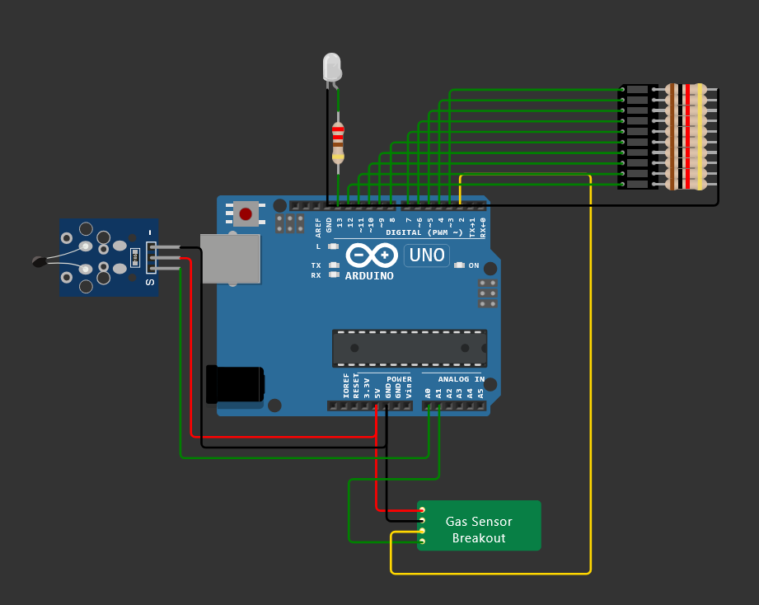
Wokwi Simulation
Gas Sensor Output LED
Temperature Sensor
Arduino Uno
Gas Sensor
Temperature Sensor Output LED Bar Graph

Slide 4
TEMPERATURE SENSOR
Decreases its resistance as the temperature increases.
This change in resistance alters the analog voltage output connected to an analog input pin on the Arduino.
The Arduino reads this analog value and calculates the corresponding temperature using a predefined formula or calibration curve.
POWER SUPPLY
GAS SENSOR
Decreases its resistance as the temperature increases.
This change in resistance alters the analog voltage output connected to an analog input pin on the Arduino.
The Arduino reads this analog value and calculates the corresponding temperature using a predefined formula or calibration curve.

Slide 5
TEMP. OUTPUT LED BAR GRAPH
Increases or decreases the number of bars displayed based on temperature.
A text message is also displayed during dangerous temperature levels.
ARDUINO UNO
Processes the analog readings from both sensors.
The Arduino also monitors the gas levels and temperature in real time through a loop.
GAS SENSOR OUTPUT LED
Starts blinking rapidly when dangerous gas levels are detected.
A text message is also displayed saying “Gas detected”.

Slide 6
ALGORITHM
1) Define Pins and Constants
1.1) Define analog and digital pins for the sensors.
1.3) Set the number of LEDs in the bar graph and assign their respective pins.
2) Setup Function
2.1) Begin serial communication at 9600 baud.
2.2) Set MQ2_ANA and MQ2_DIG as input pins.
2.3) Set the built-in LED as output.
2.4) Set all pins in the ledPins array as outputs to control the LED bar graph.
3) Loop Function
3.1) Gas Detection
3.1.1) Read the analog and digital values
from the MQ2 gas sensor.
3.1.2) If the reading is HIGH, print "Gas detected." and blink the LED.
3.2) Temperature Reading
3.2.1) Read the analog value from the temperature sensor.
3.2.2) If the temperature reading is below a certain threshold, print a warning message.
3.3) LED Bar Graph Display
3.3.1) Map the temperature reading.
3.3.2) Turn LEDs on up to the ledLevel to indicate temperature. Turn the remaining LEDs off.
3.4) Loop Delay
3.4.1) Wait for 1000 milliseconds before repeating the loop, allowing time for readings and visual updates.

Slide 7
ARDUINO CODE
#define MQ2_ANA A1
#define MQ2_DIG 2
#define TEMP_SENSOR A0
const int ledCount = 10; int ledPins[] = {3, 4, 5, 6, 7, 8, 9, 10, 11, 12}; // Pins for LEDs of bar graph
void setup() {
Serial.begin(9600);
pinMode(MQ2_ANA, INPUT);
pinMode(MQ2_DIG, INPUT);
pinMode(LED_BUILTIN, OUTPUT);
// Initialize LED pins as OUTPUT
for (int i = 0; i < ledCount; i++) {
pinMode(ledPins[i], OUTPUT);
}
}
void loop() {
// Read gas sensor values
float gas_analog = analogRead(MQ2_ANA);
int gas_digital = digitalRead(MQ2_DIG);
if (gas_digital == 1){
Serial.println("Gas detected.");
digitalWrite(LED_BUILTIN, HIGH); // turn the LED on (HIGH is the voltage level)
delay(10);
digitalWrite(LED_BUILTIN, LOW); // turn the LED off by making the voltage LOW
delay(10);
}
// Read temperature
float temperature = analogRead(TEMP_SENSOR);
if (temperature < 300){
Serial.println("Evacuate the room !");
}
else if (temperature < 450){
Serial.println("Temperature approaching dangerous levels...");
}
// Map temperature to LED levels
int ledLevel = map(temperature, 115, 953, 0, ledCount);
// Update LED bar graph
for (int i = 0; i < ledCount; i++) {
if (i < ledLevel) {
digitalWrite(ledPins[i], LOW); // Turn off LED
} else {
digitalWrite(ledPins[i], HIGH); // Turn on LED
}
}
delay(1000);
}

Slide 8
C CODE FOR GAS SENSOR
#include "wokwi-api.h" // Include Wokwi API for hardware simulation
#include <stdio.h>
#include <stdlib.h>
// Structure to hold the state of the MQ2 chip
typedef struct {
pin_t pin_ao; // Analog output pin for gas concentration
pin_t pin_do; // Digital output pin for gas detection threshold
pin_t pin_vcc; // VCC pin for power supply
pin_t pin_gnd; // GND pin for ground connection
uint32_t gas_attr; // Attribute for gas concentration percentage
uint32_t threshold_attr; // Attribute for clean air threshold
} chip_state_t;
// Forward declaration of the timer event handler
static void chip_timer_event(void *user_data);
// Function to initialize the MQ2 chip
void chip_init(void) {
chip_state_t *chip = malloc(sizeof(chip_state_t));
// Initializing pins
chip->pin_ao = pin_init("AO", ANALOG); // Set AO pin as ANALOG input
chip->gas_attr = attr_init("gas", 10); // Initialize gas attribute with default value
chip->threshold_attr = attr_init("threshold", 50); // Initialize threshold attribute
chip->pin_do = pin_init("DO", OUTPUT_LOW);
chip->pin_vcc = pin_init("VCC", INPUT_PULLDOWN);
chip->pin_gnd = pin_init("GND", INPUT_PULLUP);
// Configure timer for periodic updates
const timer_config_t timer_config = {
.callback = chip_timer_event, // Set the callback function for the timer
.user_data = chip, // Pass the chip state to the callback
};
timer_t timer_id = timer_init(&timer_config); // Initialize timer
timer_start(timer_id, 1000, true); // Start timer to call every 1000 ms (1 second)
}
// Timer event handler function
void chip_timer_event(void *user_data) {
chip_state_t *chip = (chip_state_t*)user_data; // Cast user_data to chip state
// Read gas and threshold attributes as float values
float voltage = (attr_read_float(chip->gas_attr)) * 5.0 / 100; // Convert gas % to voltage
float threshold_v = (attr_read_float(chip->threshold_attr)) * 5.0 / 100; // Convert threshold % to voltage
// Check if power is supplied correctly
if (pin_read(chip->pin_vcc) && !pin_read(chip->pin_gnd)) {
pin_dac_write(chip->pin_ao, voltage); // Write voltage to AO pin
// Check if the gas concentration exceeds the threshold
if (voltage > threshold_v)
pin_write(chip->pin_do, HIGH); // Set DO pin HIGH if threshold is exceeded
else
pin_write(chip->pin_do, LOW); // Set DO pin LOW if below threshold
}
}

Slide 9
ADVANTAGES
Early detection of hazards
Cost-effective
Customizable and scalable
Easy maintenance
Real-time alerts
Low power consumption
Arduino is open-source. This provides flexibility.

Slide 10
Thank You!

